Slide 1

Bigdata & Hadoop
by
Vasu

Slide 2
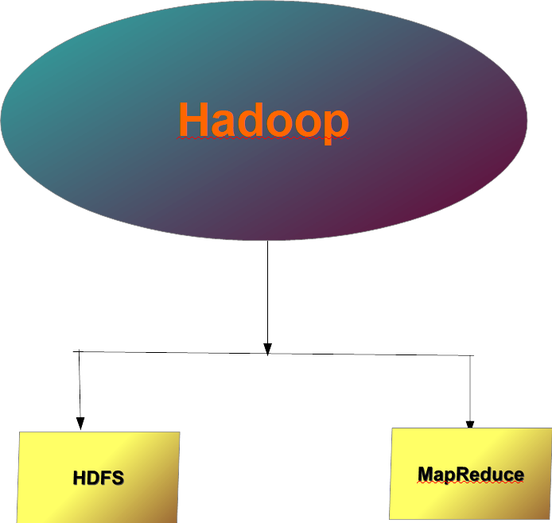
Hadoop Architecture

Slide 3
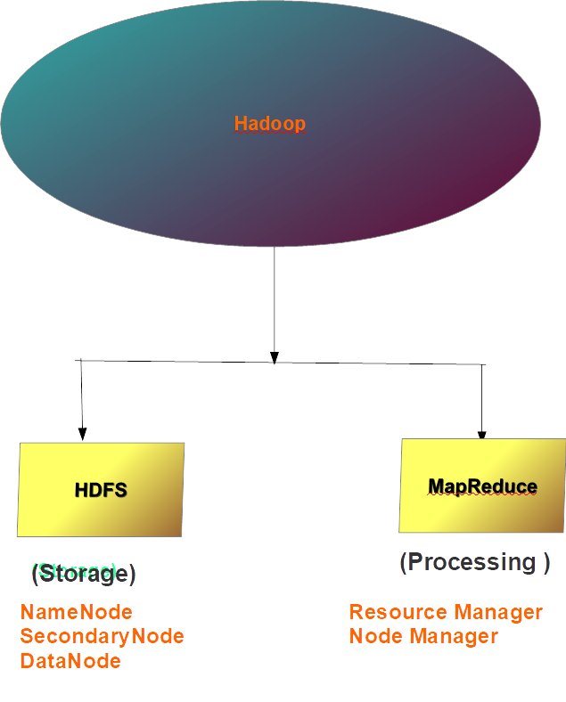
Hadoop Architecture

Slide 4
Hadoop Architecture
HDFS - a distributed storage - batch processing
MapReduce – a distributed processing - partitioned parallel processing
Cluster - an effective Network Serialization
Both HDFS & MapReduce was derived from Google’s GFS & MapReduce

Slide 5
Hadoop Architecture
NameNode (Master Node) → Maintains Metadata
Metadata → FileName, FileSize, Block ID, Block Size
No.of Replications, User, Pwd, Timestamp
→ NameSpace Management &
Block Pool Management
NameSpace → An in-memory file-system of Files & Folders
BlockPool → DataNode’s block id & IP Address are maintained in NNode’s memory
Metadata file in disk → FSImage (permanent file – Historical information)
Edits.log (temporary file - Current information)

Slide 6
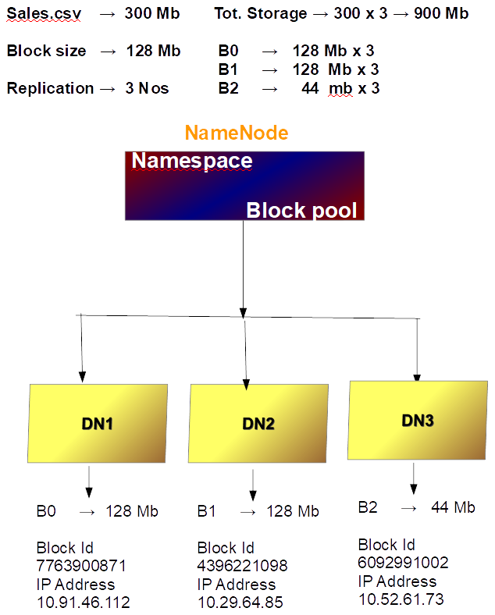
Hadoop Architecture

Slide 7
Hadoop Architecture
SecondaryNode → Maintains backup of NameNode’s metadata
→ Stand by Node
→ FS Image & Edits.log
→ Check pointing (Merge Edits with FS Image)
NameNode ← New FS Image
Checkpoint (default) → 1) edit.log size is full or exceeds size
2) edit.log received more than one-million transactions
3) Regularly at every one-hour intervals

Slide 8
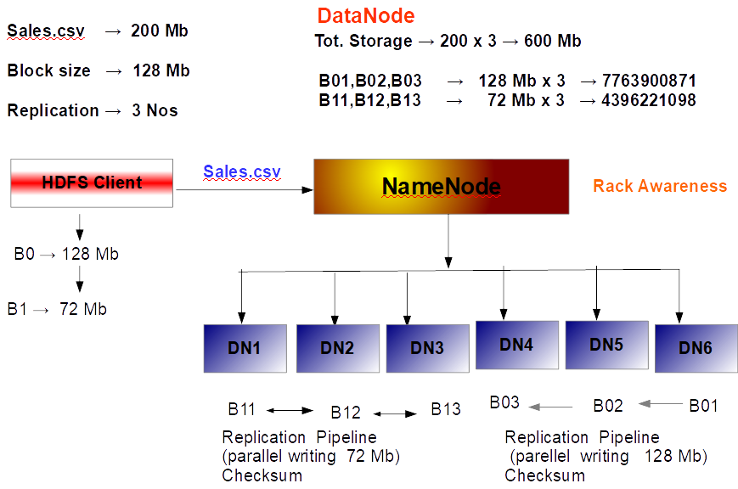
Hadoop Architecture

Slide 9

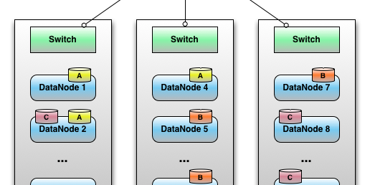
Hadoop Architecture (Rack)
Rack – Multiple Data Nodes (50-100) arranged in one network switch(Ethernet)

Slide 10
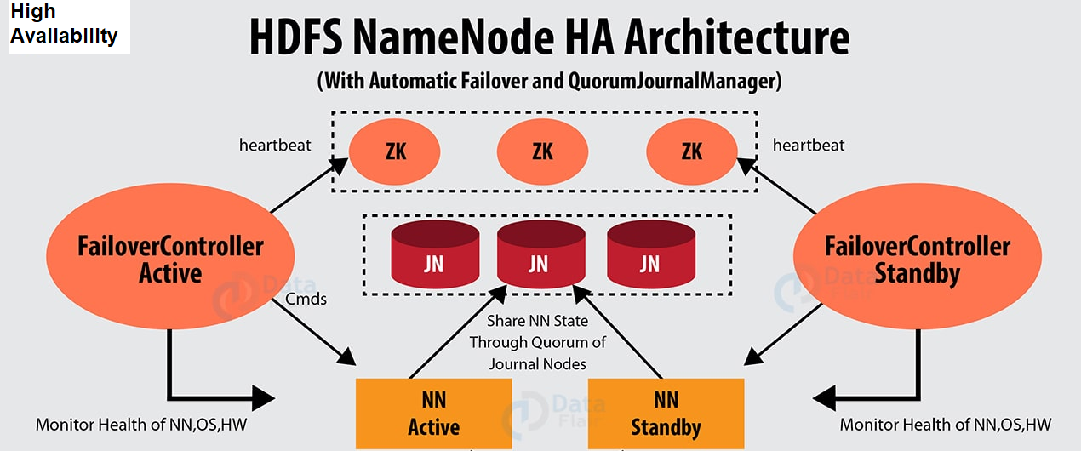
NameNode - High Availability
Zookeeper is software or tool provides co-ordinating service in Hadoop distributed Environment .
Zookeeper synchronizes various applications and handles failures

Slide 11
HDFS Process – Work-flow
Client (HDFS) -→ Master (NameNode) -→ Slave (DataNode)
HDFS Client splits the file into blocks (128 mb) and stores in local cache
NameNode receives request and provides lease/permission to HDFS client (User) to write the blocks into DataNode
Assume, incase of 3 replication factor, First the data is copied in to the local rack node , then next replica is placed in remote rack node and final replica is copied on to same remote rack in another node
Replication Pipeline Parallelism is achieved, the moment the first replica is copied into the local rack node. DataNode, they interact with each other and share the data from previous block.
Checksum is used to confirm the replication write procedure
DataNode shares the information of block id & Node location (IP Addresss) to NameNode by writing into Edits.log
When all the blocks are copied. HDFS Client close the job
When

Slide 12
Hadoop Execution Modes
Standalone Mode (one JVM)
2) Pseudo Distributed Mode ( Single Node Cluster , Separate JVM)
3) Fully Distributed mode ( Multi-Node Cluster, Separate JVM & YARN )

Slide 13
Hadoop_ v1 & v2
Version 1 Version 2 (YARN)
NameNode (One) NameNodes (Two)
JobTracker Resource Manager (One)
TaskTracker Node Manager
YARN - Resource management & Job Scheduling running as a separate service
Resource Manager - Manages Over all resource allocation . A Master Node
Node Manager - Responsible for execution of Job in Data Node
AppMaster - Works with NM for running tasks & negotiating with RM for additional resources
Container - Capacity Management - CPU , Memory, Disk & Network
Job Scheduler - Fair Scheduler & Capacity Scheduler (Selecting a container)
Fair Scheduler - All application gets equal share of resources
Capacity Scheduler - Guarantees allocation of resources under peak time

Slide 14
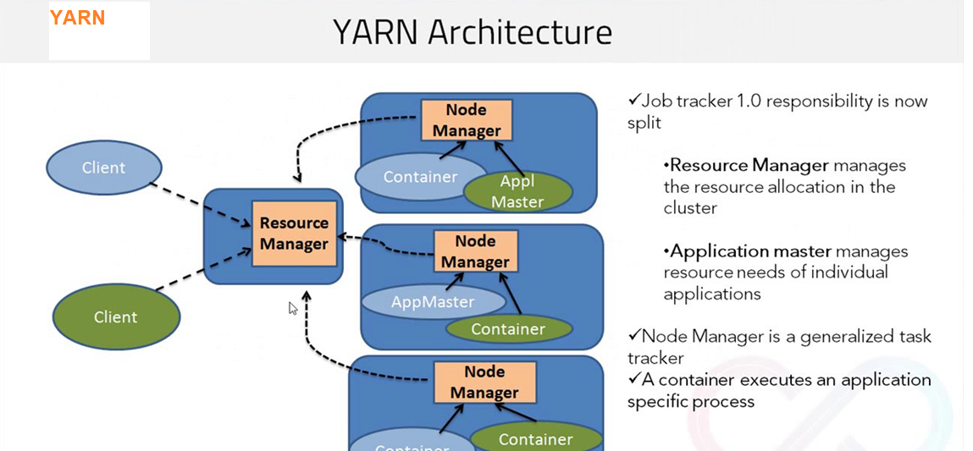
YARN - Yet Another Resource Negotiator

Slide 15
Master – Slave Architecture
Hadoop is Master → Slave Architecture
Hallmark of Hadoop Cluster is …
a) Horizontal Scalability
b) Distributed computation
Rack Awareness--
HDFS cluster designed to store large datasets as blocks in multiple Data Nodes
Rack Awareness maintains Data Node Status (volume information)
Name Node uses Rack Awareness for the allocation of Blocks for placement
Rack Awareness handles fault tolerance , Blocks Read-write in HDFS cluster
HDFS Blocks are – Write once – Read Many - immutable – not changeable

Slide 16
Master - Slave Architecture
Hadoop is Master → Slave Architecture
Master Slave Heart beat
NameNode DataNode - 3 sec, 60 sec
Resource Manager Node Manager - 3 sec
SecondaryNode

Slide 17
Hadoop Version 3
New Features in version 3.0
1) Erasure coding
Balances fault tolerance and storage efficiency . Uses parity block - RAID. Alternative to old Replication
2) YARN Timeline Service 2 (server)
Instead of using single read/write & storage in Timeline Server 1.0, YARN Version 2.0
using multiple collectors or Writers tor Data storage (Queue,user,Job) . Improved Scalability
3) More than 2 Standby NameNodes – Backup
For high availability provides two stand by NameNodes
4) Intra DataNode Disk-Balancer (volume info of all DNodes)
Replaces old Re-balancer technique of HDFS to Inter Disk-Balancer to Intra-Disk Balancer . evenly
distributed data by using Round Robin method of available spaces in all data nodes
To be enabled – dfs.disk.balancer.enabled=true (hdfs-site.xml)
5) Heap Size
Min & Max heap size introduced instead of default value

Slide 18


Vasu

